Slide 1
Patronage

Slide 2
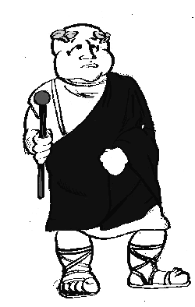
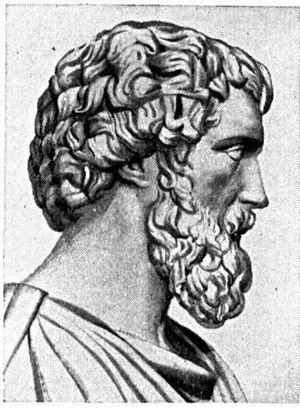
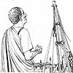
PATRON CLIENT RELATIONSHIP
EMPEROR nominates
SALVIUS to an
important priesthood.
SALVIUS obtains
Building contract
For HATERIUS.
HATERIUS orders
Distribution of
Sportula to CLIENTS.
You scratch my back and I will scratch yours!

Slide 3
Give and Take
Patroni
Sportula
Food
Money
Protection
Referrals
advice
Clientes
Political support
Accompany at events
Witness wills
Pack dinners
Entourage

Slide 4
Roman Society
EMPEROR
SENATORIAL CLASS
EQUESTRIAN
CLASS (EQUITES)
PEOPLE
(PLEBS)

Slide 5
The Emperor
All purple toga – toga picta
Head of all patrons
Lives on Palatine Hill
Held consulship and pontifex maximus permanently

Slide 6
Senators
Political leaders
Elected, born into it, or bestowed upon them
Wide purple stripe – toga praetexta
1 million sesterces requirement
Live on Esquiline hill

Slide 7
Equites
Upper-middle class – requirement of 400,000 sesterces
Many equites were businessmen, although many were active in politics. Only a member of the equestrian class might be governor of Egypt.
Could wear a gold ring as a status symbol and a toga with a narrow stripe – tunica angusticlavii

Slide 8
Plebs
Wide range of jobs and finances
Majority of people, but not slaves or wealthy
Heavily rely on patrons
Live in insulae in Subura

