Slide 1
Stage 37 Culture

Slide 2
The council (#1-4)
Aka consilium
Aka amici principis
Helps emperor deal with workload and keep the favor of the people
Invited by the emperor, it was not a fixed membership
typically senators or equites

Slide 3
New emperor means… (#5)
New consilium – want to pack the audience with yes men
Even though emperor has final say, he wants to keep up the appearance of the Republic

Slide 4
Advice Needed (#6)
Matters varied greatly
help during crisis
What to do about the famine?
help on delicate matters
Who will be my heir?
advice on foreign affairs
Should we invade Germany?
advice on local issues
How much should we tax?
Should we find them guilty?

Slide 5
Council Speaks (#7-10)
Members offer their sententiae (opinions)
In theory, members could speak freely
In practice, under some emperors, it was dangerous to disagree with the emperor
Emperor may deliberate alone or make split decision
Emperor not bound by opinions of consilium, and can ignore it (but he needs to keep people happy)

Slide 6
Cursus Honorum

Slide 7
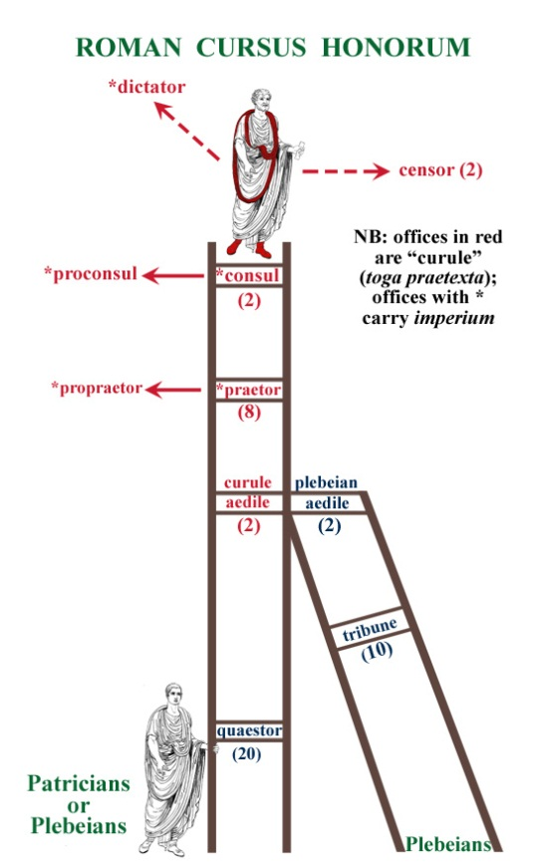

Slide 8
The ladder of success (#1-4)
Men in the senatorial class compete with each other for official positions
While climbing up, his status and responsibilities increase.
Some positions are mandatory and are prerequisite for other positions
Some positions had age restrictions
suo anno – gain the position in earliest year possible

Slide 9
Gaining positions (#4)
Some officials were chosen by the emperor
Others elected by the senate (but emperor puts in his own opinion)
Emperor can grant special permission for a man to skip a step on the ladder

Slide 10
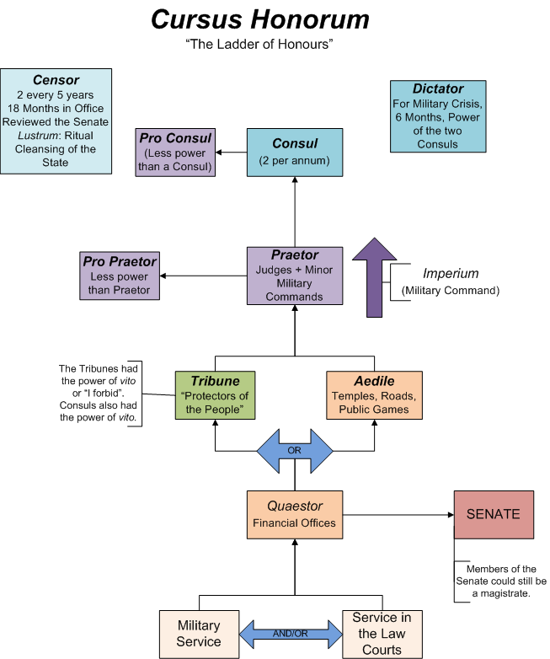

Slide 11
Bottom - vigintivir
1 yr term
Help in management of law courts and prisons
Minting of Roman coinage

Slide 12
Tribunus militum
Serve as an officer in the legion
Typically 1 year

Slide 13
Quaestor
Management of public money
1 year
This position resulted into entry into the senate

Slide 14
Tribunus plebis or aedile
Tribunus
1 of 10
Originally act as helpers to plebs
Lost most power by empire
Aedile
1 of 6
Keep up public buildings
Aid in putting on entertainment

Slide 15
Praetor
Run law courts
Now eligible for positions abroad (pro-praetorships) – e.g. – govern a province, command a legion (praefectus)

Slide 16
Top - Consul
2 men
Preside over senate meetings
Supervise government business
Ex-consuls govern most important provinces
Novus homo – 1st member of family to make it to consulship

Slide 17
Cream Rises to the Top (#7)
Not all men made it to consul
Lets emperor see the best men
Gives men opportunity to show their skill set

Slide 18
Agricola – good with soldiers
Tribunus militum in Britain
Quaestor in Asia
Tribunus plebis
Praetor
Legatus
Pro-praetor of Aquitania
Consul
Pro-praetor of Britain
Pliny - good with money
Vigintivir
Tribunum militum in Syria
Quaestor in Rome
Tribunus plebis
Praetor
Praefectus aerarii militum
Praefectus aerarii Saturnii
Consul
Augur priesthood
Curator Tiberis
Legatus Augusti

