Slide 1
Vestimenta et Vita

Slide 2
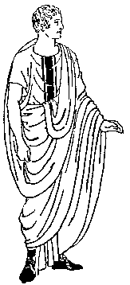
Vestimenta Caecilii
Caecilius vestimenta gerit
Tunicam
Togam
Calceos
color of the toga is significant, marking differences in age and status:
toga virilis: unadorned toga in the off-white color was worn by adult male citizens
toga praetexta: off-white toga with a broad purple border. The only adults allowed to wear this toga were magistrates
toga pulla: toga made of dark-colored wool worn during periods of mourning
toga candida: artificially whitened toga worn by candidates for political office
toga picta: purple toga embroidered with gold thread worn by a victorious general and later adopted by emperors for state occasions.

Slide 3
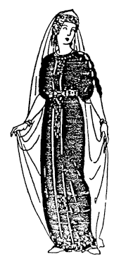
Vestimenta Metellae
Metella vestimenta gerit
Tunicam
Stolam
Pallam

Slide 4
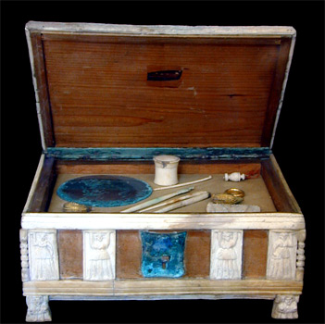
Hair and Make-up

Slide 5
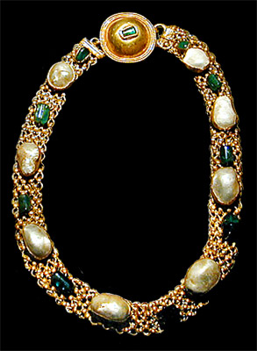
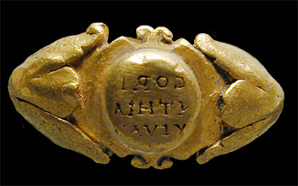
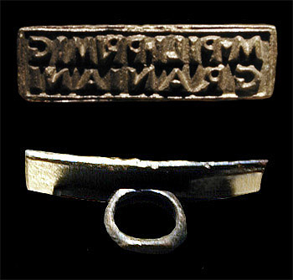
Jewelry

Slide 6
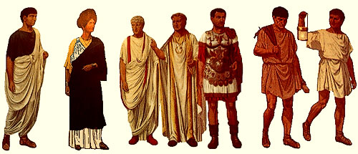
Clothing = status
Citizen married senator emperor soldier lower slave?
Not wealthy woman class?

Slide 7
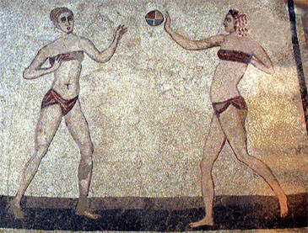
subligar or subligaculum

Slide 8
Vita Caecilii
Wake up
Wash up and dress
Ientaculum
Salutatio
Caecilius = patronus
Forum
barber, business, baths
Prandium
Forum
Cena

Slide 9
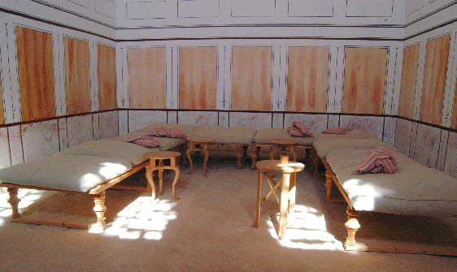
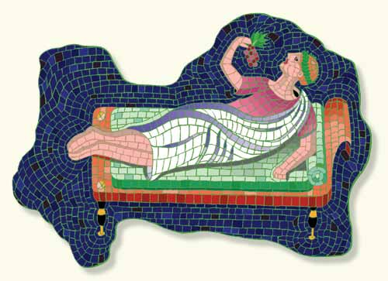
Cena – ab ovo usque ad malum!
In triclinio
Mensa
Tres lecti
Magna cena
Romani lente cenant.
Romani recumbunt.

Slide 10
Order of dinner
Primarily for the rich, it consisted of three parts.
The Gustatio or a Promulsio was the first part (appetizers). This course included things like salads, radishes, mushrooms, eggs, shellfish, etc. It was followed by a drink of mulsum or wine sweetened with honey.
The Prima Mensa was the main course of the meal. However, there were even up to six or seven main dishes in this course. Guests would have to choose from a variety of fish, poultry and meat. After this part of the meal was finished, an offering of wheat, salt and wine would be made for the household gods on the family altar.
The Secunda Mensa was the final part of the meal and was made up of desserts. Cakes sweetened with honey as well as apples, pears, grapes, nuts and figs might be served. This part of the meal would also be accompanied with a wine/water mixture.
The Vesperna was a light supper that existed in the earlier years because often the cena was eaten so early that people were hungry again by night fall. This meal disappeared because it was no longer needed as the Romans began to have their cena at a later time.

Slide 11
Patroni et Clientes
Patroni
Clientes
(Divitiores) Richer
Argentarii
Senatores
Imperator
Patronus pecuniam dat.
Patronus auxilium dat.
Patronus clientes custodit.
Pauciores et liberti
Olim servi
scriptores
artifices
Clientes cotidie patronum salutant.
Clientes cum patrono publice ambulant.

Slide 12
Quid de feminis?
Every day things in the house
Manage slaves
Teach children
Weave
Visit friends or temples

